Slide 1

Integrated Postsecondary Education Data System (IPEDS) Insights - 2013
Data Visualization – Final Project
By Avinash Kustagi
Notes:
Source: National Center for Education Statistics
http://nces.ed.gov/ipeds/Home/UseTheData

Slide 2
Overview Of IPEDS Insights from National Center for Education Statistics
Notes:
This presentation covers the brief overview of Integrated Postsecondary Education Data System (IPEDS) Insights from NCES.
What is NCES?
National Center for Education Statistics (NCES) is the primary federal entity for collecting and analyzing data related to education. I am using the IPEDS 2013 data to find out the trends and education statistics across the United States.
By end of the presentation, we would have a brief idea about
How the universities are located across The United States, with the glimpse about Tuition Fee & Total Enrollment
Who is at the top in the race of Religious Affiliations
How universities are located in term of Urbanization
Most expensive universities to live on campus
Universities with dramatic change in their fee structure from 2010 to 2013
Box and Whisker plot insight about Tuition Fee, Acceptance Rate, and Admission yield across top 10 states in The United States
Details about Highest degree offered across top 10 states
Scatter plot of % Admitted Vs % Enrolled; % Admitted Vs No of Applicants; No of Applicants Vs Price for living on Campus
Effect of Tuition fee on the enrollment by different races

Slide 3
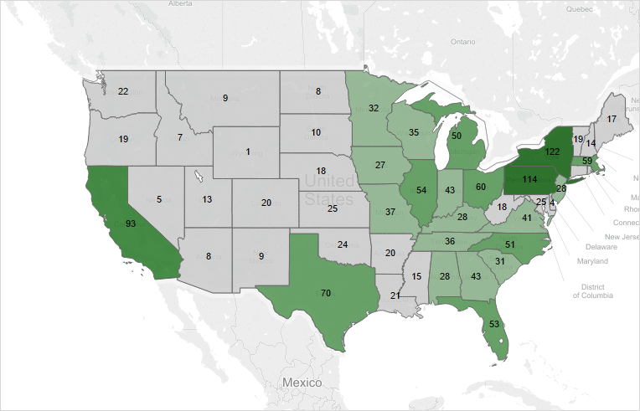
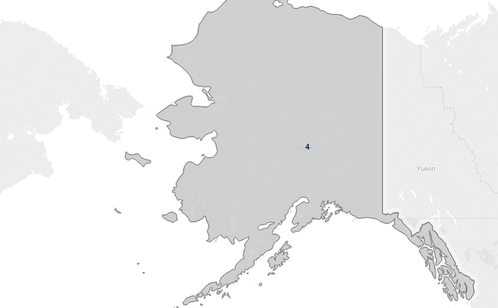

No. of Universities by State
Note: Alaska and Hawaii has got 4 and 7 Universities respectively
Notes:
NOTE: Slide 3
This view mainly focuses on how the universities are located across The United States.
From the view, it clearly shows that most of the University located either east or west coast of The United States
New York state having highest no of universities i.e. 122, followed by Pennsylvania and California with 114 and 93 universities respectively
Notably, there is lot of scope for higher education development in Central and North American States, especially in the states such as Wyoming (1), Nevada(8), Montana(9), North Dakota (8), Arizona (8), New Mexico (9), Idaho (7); having lesser than 10 universities in their states.

Slide 4
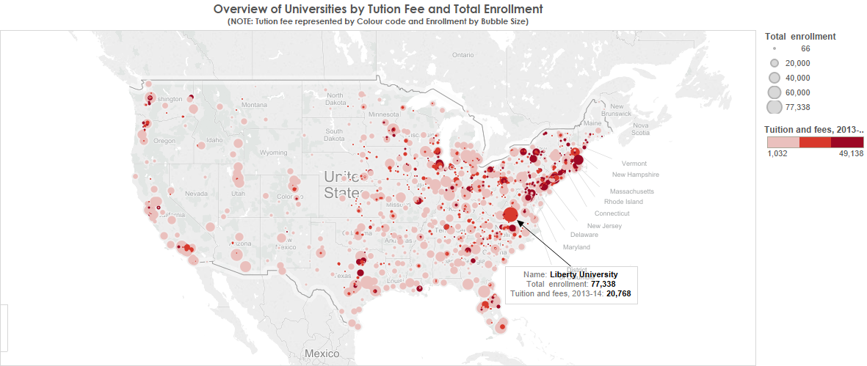
Notes:
NOTE: Slide 4
This view gives the basic idea about the exact location of the university in the US, the color code represents how expensive it is, and the bubble size indicates No. of enrollments. Example: The marked annotate shown for Liberty University; the color code shows it is moderately expensive with fee $20,768; also the bubble size indicates the massive number of enrollments approximately 77,338.
From the view, it clearly shows that most of the University located either east or west coast of The United States
The color code shows the eastern coast universities are more expensive than the western coast, with huge no of enrollments.

Slide 5
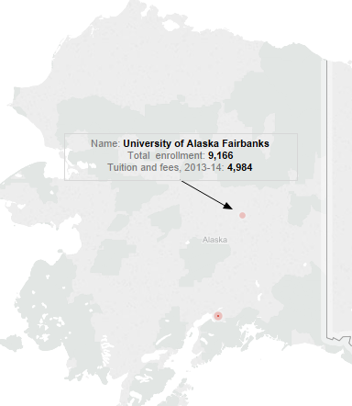
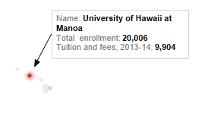
Overview of Universities by Tuition Fee and Total Enrollment
Notes:
NOTE: Slide 5
This view is same as the previous, but specifically showing only for Alaska and Hawaii states

Slide 6
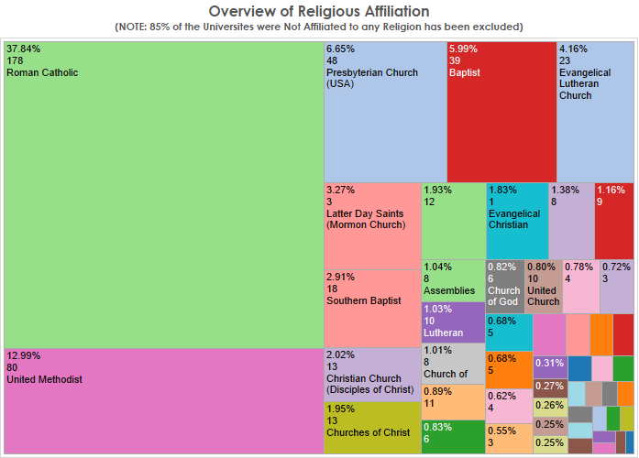
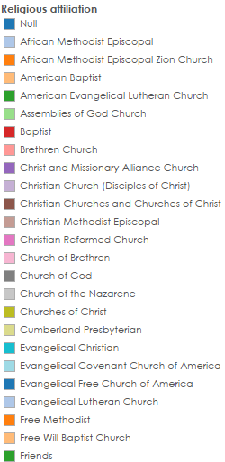
Notes:
NOTE: Slide 6
The Treemap gives the overview of Religious affiliation.
Notably, more than 85% of the universities are not affiliated with any religion, which is been excluded from this view.
However considering the affiliations, Roman Catholic having the most no affiliations, followed by United Methodist and Presbyterian Church respectively.
These three combine together holds more than half off The US religious affiliated universities

Slide 7
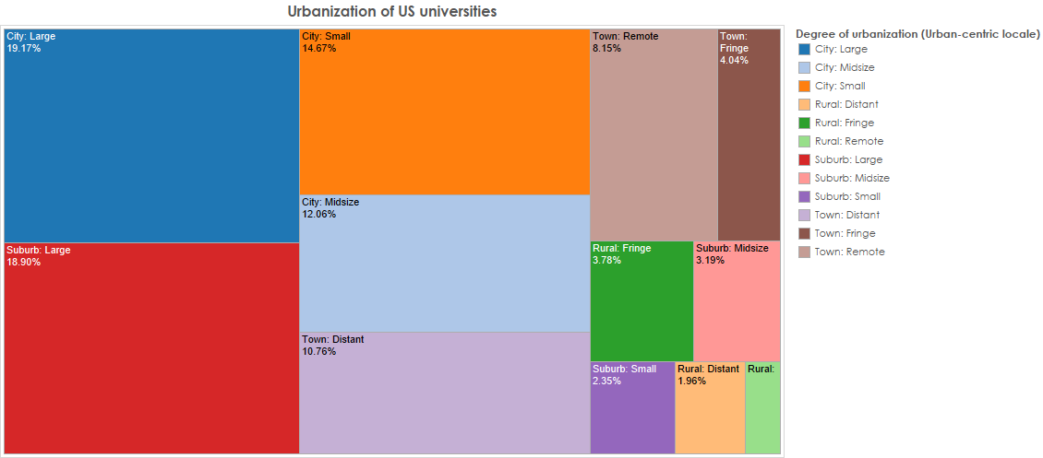
Notes:
NOTE: Slide 7
This Treemap gives the overview of Urbanization of US universities.
It clearly shows that, City large having the highest Nos of Universities followed by Suburb large and City Small respectively
These three combine together holds more than half off The No. of US universities

Slide 8
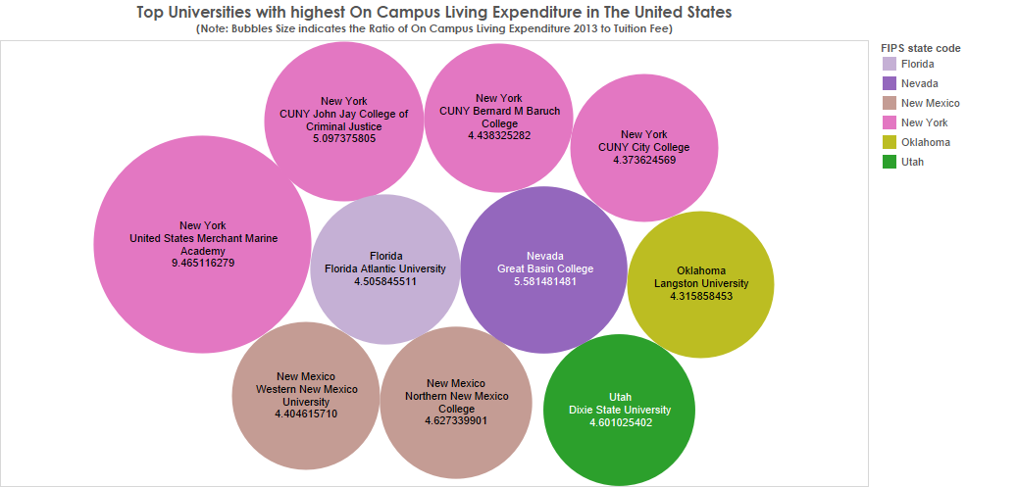
Notes:
NOTE: Slide 8
This bubble chart shows the list of the Top 10 universities, which are treated as the most expensive universities in The United States to live on campus. Bubbles Size indicates the ratio of On-Campus Living Expenditure to tuition fee in 2013, Higher the bubble size more expensive the University. The number specifically shows how many times it is more expensive than the tuition fee.
Example: Living On campus in United State Merchant Marine Academy, will cost you 9.46 times the cost of tuition fee.
From the view, we can summarize that United State Merchant Marine Academy is the most expensive university (considering the ratio of On-Campus Living Expenditure to tuition fee), followed by Great Basin College and CUNY John Jay college

Slide 9
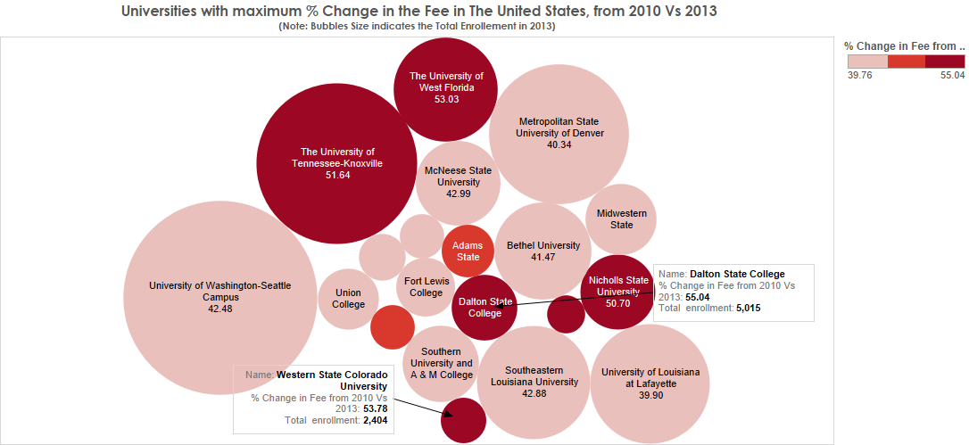
Notes:
NOTE: Slide 9
This bubble chart shows the universities with maximum % change in the fee from 2010 to 2013, and bubble size captures the no. of enrollments for 2013.
Dalton State College being the most sensitive university showing over 55% increase in the Tuition fee from 2010 to 2013, followed by Western State Colorado and The University of West Florida with 53.7% and 53% respectively.
From this cluster, we can also observe, the University of Washington – Seattle being most successful university to attract the huge no of enrollments, after having this massive increase in the fee from 2010 to 2013. Similarly, the University of Tennessee–Knoxville is also doing good in the no of enrollments.

Slide 10
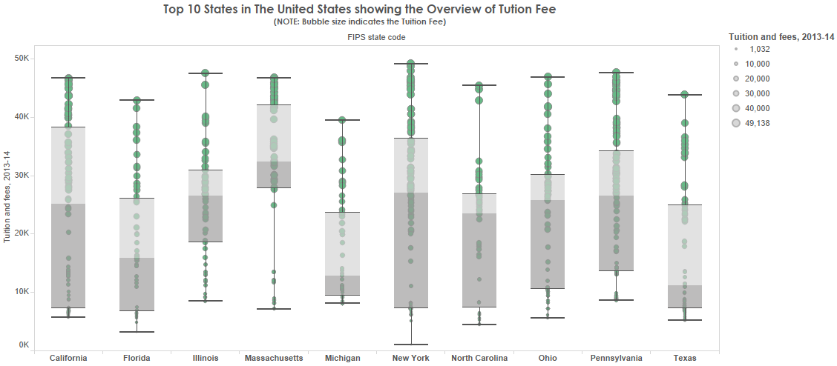
Notes:
NOTE: Slide 10
Box and Whisker plot insights about Tuition Fee across top 10 states in The United States
Interestingly, New York is the state with highest Whisker range, having highest upper Whisker of $ 49,138 (Columbia University – most expensive university among top 10 states); and least lower whisker of $1,032 ( United State Merchant Marine Academy - lease expensive university among Top 10 states)
However, Massachusetts could be considered as the most expensive state to study. Because it records the,
Highest Lower Quartile - $27,748 ( it means more than 75% of universities are charging more than $27,748 as fee)
Highest Median – $32, 375 (50% of the Universities are charging more than this amount)
Highest Upper Quartile – $41,989 ( almost 25% of universities are charging $41,989 and more as fee)

Slide 11
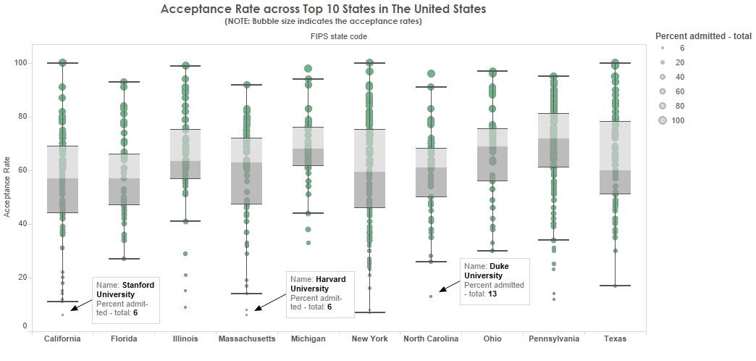
Hard to get admitted in these universities
Notes:
NOTE: Slide 11
Box and Whisker plot insights about Acceptance Rate across top 10 states in The United States
As approaching towards 0 in the Y – Axis, Acceptance rate tend to decrease, and it is really difficult to get through in these universities (some of them are annotated, like Harvard University, Stanford University, and Duke University etc...)
Interesting Facts:
Michigan State has the highest Lower Quartile of 61.5% ( it means more than 75% Universities in this state has the acceptance rate of 61.5% and above – Probability of getting selected in Michigan State is easier than any other Top 10 states)
Florida has the lowest Upper Quartile of 66% (it means more than 75% Universities in this state has the acceptance rate of 66 % and below, it is lease among all other states – Probability of getting selected in Florida is harder compared to all other states)

Slide 12
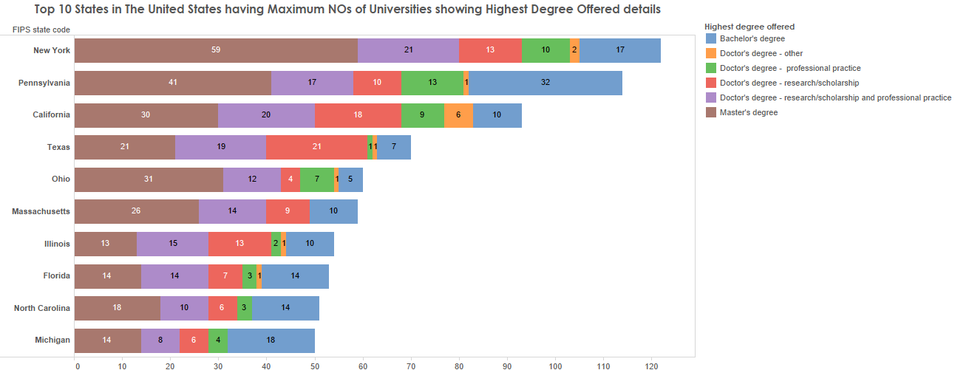
Notes:
NOTE: Slide 12
Stacked Chart shows the Top 10 states having maximum no. of universities, and gives the details about highest degree offered
We could see the New York is the state with highest no. of universities followed by Pennsylvania and California
But Pennsylvania has the highest no of university (32) which are mainly focusing on Bachelor’s degree than any other states
Similarly, in New York has the maximum no of university (51), which are mainly focusing on Master’s degree

Slide 13
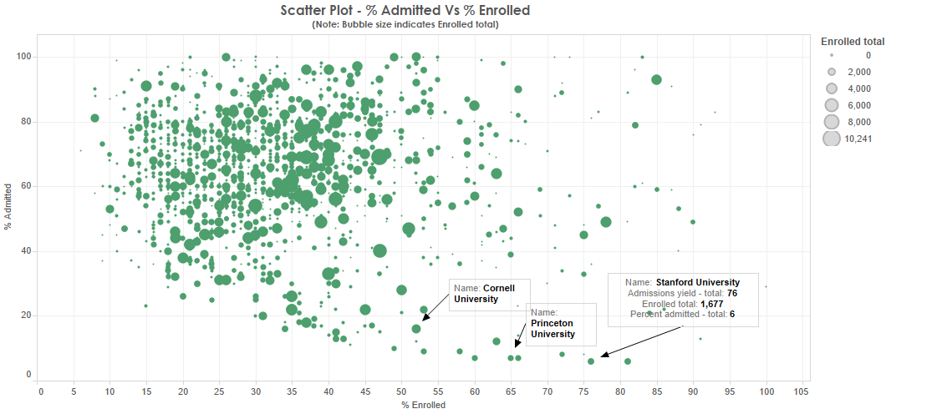
Notes:
NOTE: Slide 13
Scatter plot of % Admitted Vs % Enrolled, bubble size shows enrolled total.
As approaching towards 0 in the Y – Axis, Acceptance rate tend to decrease, and it is really difficult to get through in these universities (some of them are annotated, like Princeton University, Stanford University, and Cornell University etc...)
We could also see that lower the acceptance higher the % enrolled

Slide 14
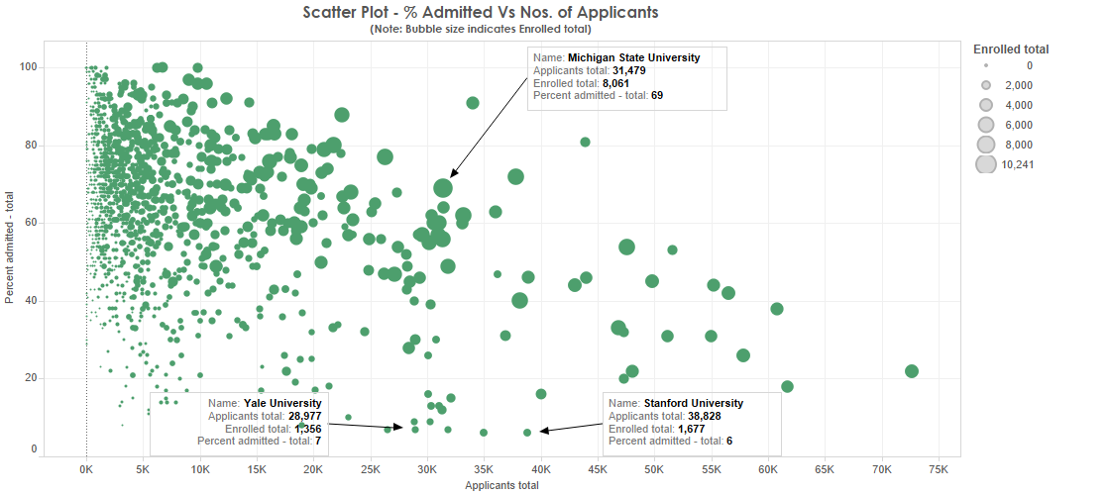
Notes:
NOTE: Slide 14
Scatter plot of % Admitted Vs Applicants total, bubble size shows enrolled total.
As approaching towards 0 in the Y – Axis, Acceptance rate tend to decrease, and it is really difficult to get through in these universities (some of them are annotated, like Yale University, Stanford University etc...)
Bigger the bubble, greater the no. of enrolled, ( example: Michigan State University)

Slide 15
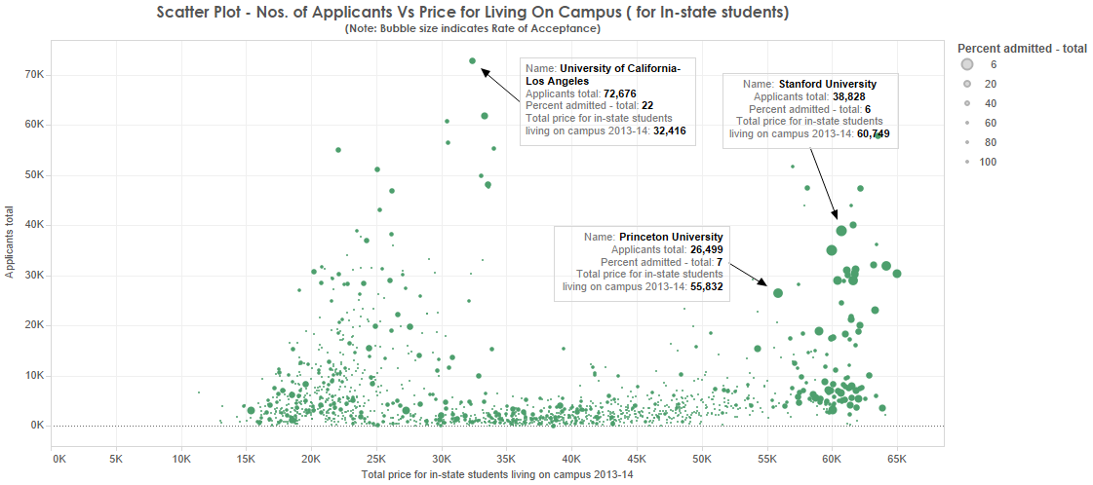
Notes:
NOTE: Slide 15
Scatter plot of No of Applicants Vs Price for living on campus (for in-state students), bigger the bubble, harder to get selected in the university
Surprisingly there is 2 clusters:
Cluster with fee < 50K & bigger bubble – As annotated, Universities like, the University of California – Los Angeles, these are the universities which are really good to target.
Cluster with fee >50K & bigger bubble – As annotated Universities like Stanford, Princeton; these are most expensive and reputed universities to get through

Slide 16
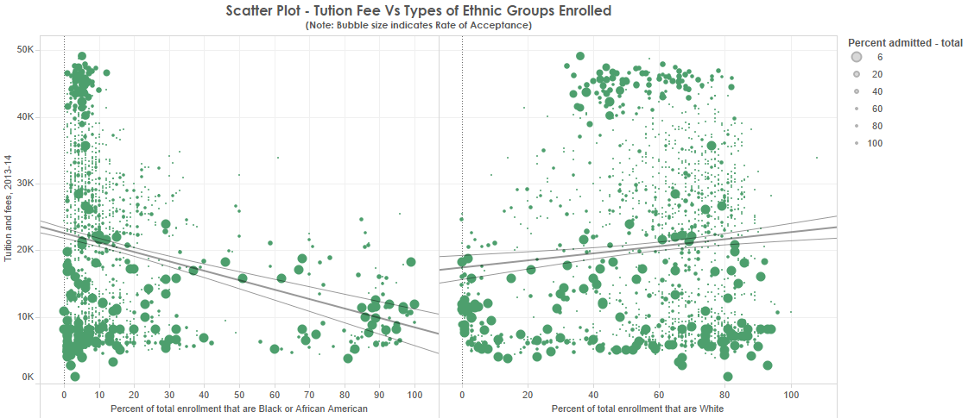
Notes:
NOTE: Slide 16
Scatter plot of Tuition Fee Vs % of Ethnicity; bigger the bubble lower the acceptance, harder to get selected in the university
Interestingly, there is a Negative correlation between, Tuition Fee Vs % of Black or African American enrolled. It means higher the fee lower the No. of African Americans enrolled in the university
However, there is a positive correlation between Tuition Fee Vs % of White American enrolled

Slide 17


